Slide 1

McGraw-Hill Technology Education
Copyright © 2006 by The McGraw-Hill Companies, Inc. All rights reserved.

Slide 2
Chapter 12A
The Basics of Information Systems

Slide 3
Purpose of Information Systems
Information systems
  Collects, stores and organizes information
  Retrieves value from data
  Harness many types of data
  Computer’s reason for existence

Slide 4
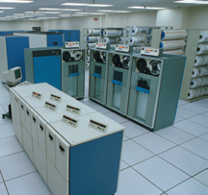
Purpose of Information Systems
Components of an information system
  Physical means of storing information
  Procedures for ensuring data integrity
  Rules regarding data use and distribution
  Means of distributing the data
  Tools to organize the data
Notes:
Teaching tip
Data integrity is the most important portion of the IS. Many administrators have lost jobs due to failure in applying data integrity rules.

Slide 5
Types of Information Systems
Office automation systems
  Performs various office tasks
  Allows users to efficiently handle data
  Tedious tasks become simple
  Built using off-the-shelf systems
  Allow seamless integration of data
Notes:
Discussion point
Microsoft Office is the dominant product, costing several hundred dollars. OpenOffice is a compatible product, costing nothing. Why do organizations continue to use MS Office instead of OpenOffice? For more information on OpenOffice, see http://www.openoffice.org/.

Slide 6
Types of Information Systems
Transaction processing systems (TPS)
  Transaction is a complete event
    Completed in a series of steps
  Tracks and processes transactions
  Each step is monitored
    Details sent to the appropriate person
  Errors must be remedied immediately
Notes:
Teaching tip
An excellent example of a TPS is FedEx and UPS’ tracking systems. Users can enter in the tracking number at any time, and receive a rough estimate of it’s location in transit.

Slide 7
Types of Information Systems
Management information systems (MIS)
  Tools for managers and decision makers
  Organizes and evaluates information
  Summarizes reports based on need
    Managers require different views of data

Slide 8
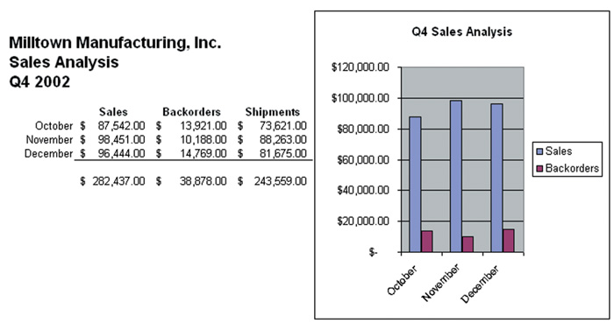
Management Information System

Slide 9
Types of Information Systems
Decision support system
  Organizes information for better decisions
  Different data and criteria are evaluated
  Often based on spreadsheet software
  Provides tailored and structured reports
Notes:
Teaching tip
The site http://www.letstalk.com/ provides a simple DSS that helps users select a cell phone and plan based on need.

Slide 10
Types of Information Systems
Expert systems
  Perform tasks done by a person
  Analyze data and suggest an action
  Requires a large knowledge base
  Inference engines
    Analyze the data
    Make the decisions

Slide 11
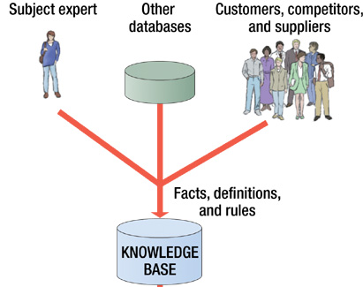
Expert System

Slide 12
Information Systems Technology
Intranets
  Private network using internet technology
  Employees use to access data
  Databases are stored on the Intranet
  Access to outside users is blocked
Notes:
Teaching tip
Remind the students that Intranets were covered in chapters 9 and 10.

Slide 13
Information Systems Technology
Extranets
  Outside access to an intranet
  Goal is to simplify a process
  Just-in-time inventory
    Manufacturer keeps little material in stock
    Arranges to have stock delivered daily
Notes:
Insider information
Michael Dell, the founder of Dell computers, was one of the earliest adopters of just-in-time inventory. His factories received daily shipments of products for the computers. Very little supplies were kept in stock.

Slide 14
Information Systems Technology
Virtual Private Networks
  Secure connection over the Internet
  Tunneling provides security
    Data transmitted in an encrypted packet
  Employees use to work from home
  Networks use to connect securely
  Once established, the VPN is transparent
Notes:
Teaching tip
Encapsulation allows the packet to hide in plain sight. Millions of normal packets travel the Internet every second. The outer packet looks like every other packet.

Slide 15
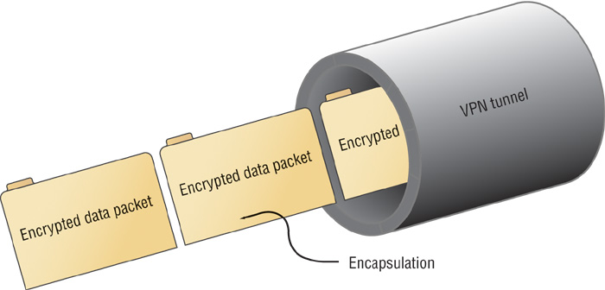
Virtual Private Network

Slide 16
Information Systems Technology
Electronic data interchange (EDI)
  Electronic transfer of data
  Data transferred in a precise manner
  Networks often share an information system
  Over time can save organizations money
Notes:
Teaching tip
Remind students of XML, presented in chapter 2. Recent EDI uses XML to facilitate data transfers

Slide 17
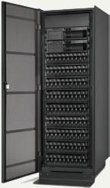
Information Systems Technology
Data warehousing
  Provides 24x7 access to data
  Fault tolerant
  Data security

Slide 18
Information Systems Technology
Data scrubbing
  Provides for data consistency and validity
  Compares data to a set of rules
    Failures are repaired or removed
  Should be performed at all levels
    Data entry
    Storage
  As rules change data is rescrubbed

Slide 19
Information Systems Hardware
Server farms
  Collection of servers and mainframes
    Servers work together
  Servers are either distributed or collected
  Uses of server is critical

Slide 20
Information Systems Hardware
Enterprise storage
  Methods and technologies to store data
  Efficiently store large amounts of data
  Data is accessible at all times
  RAID and NAS are two types

Slide 21
Information Systems Hardware
RAID
  Redundant Array of Inexpensive Disks
  Links a number of hard drives
  Provides data redundancy
  Can speed access to data
  RAID 0
    Disk striping
  RAID 1
    Disk mirroring
  RAID 3, 4, and 5
    Disk striping with parity
Notes:
Teaching tip
Many online collections are mirrored around the world. This speeds and guarantees access to the drive. Apache.org is an example of a site that is mirrored worldwide.

Slide 22
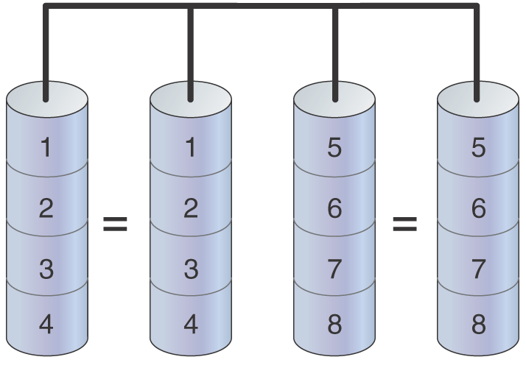
RAID 1 Multiple Disk Mirror

Slide 23
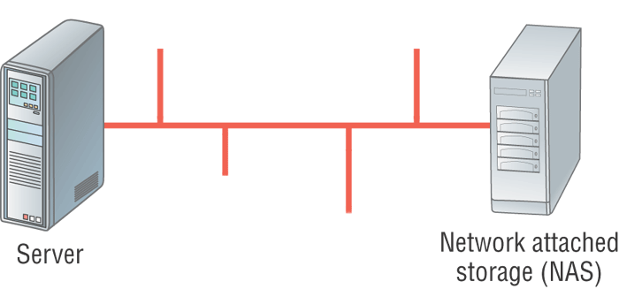
Information Systems Hardware
NAS
  Network Attached Storage
  Disk storage connected to network media
  Disk system processes and delivers data
  Storage Area Networks (SAN)
Notes:
Teaching tip
Figures 12A.14 and 12A.15 on page 473 provide excellent examples of NAS and SAN.

Slide 24
Information Systems Hardware
Backup
  Protects files and settings
  Can restore data to an earlier point
  Crucial to any information system
  Transaction rollback
    Logs changes to a file
    Changes are undone when necessary
  Tape backup
    Copies files to a tape
    Files need recopied when necessary
Notes:
Discussion point
Have students understand why backup tapes are stored offsite. Have them describe the pros and cons of offsite storage.

Slide 25
Information Systems Hardware
Nonstop and redundant systems
  Mission critical system
  Must run 24x7
  Most information systems mission critical
  Redundant systems are backup computers
    Backup takes over when necessary
Notes:
Teaching tip
A good analogy for mission critical is to compare systems in an airplane. Hydraulic control over flaps and ailerons are crucial to controlling the plane. Modern airliners have two redundant systems for controlling the flaps and ailerons.

Slide 26
Information Systems Hardware
Scalable and interoperable systems
  Scalability
    Defines a systems ability to grow
    Software and hardware grows
  Interoperable systems
    Work with other systems
    Little configuration is needed

Slide 27
Information Systems Department
Integral part of any organization
Maintains equipment, software and data
Enables other employees to function
Requires highly trained employees
Various names
  Information Systems (IS)
  Information Technology (IT)
  Management Information Systems (MIS)

Slide 28
Chapter 12A
End of Chapter

